Slide 1




Generalized Motorcycle Graphs for Imperfect Quad-Dominant Meshes
Nico Schertler, TU Dresden, Germany
Daniele Panozzo, NYU, USA
Stefan Gumhold, TU Dresden, Germany
Marco Tarini, University of Milano / ISTI-CNR, Italy
Notes:
0:00 – 0:29

Slide 2
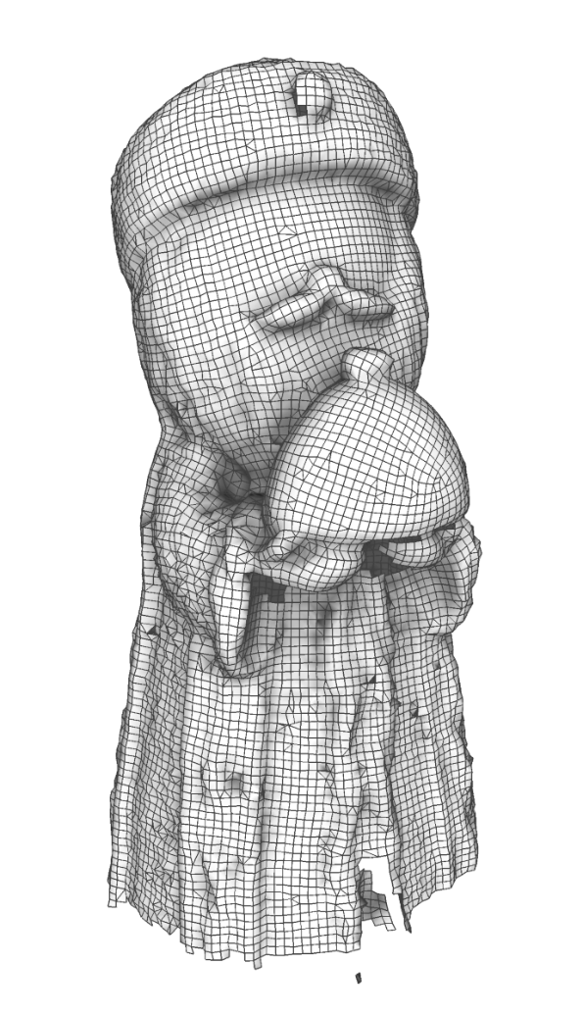
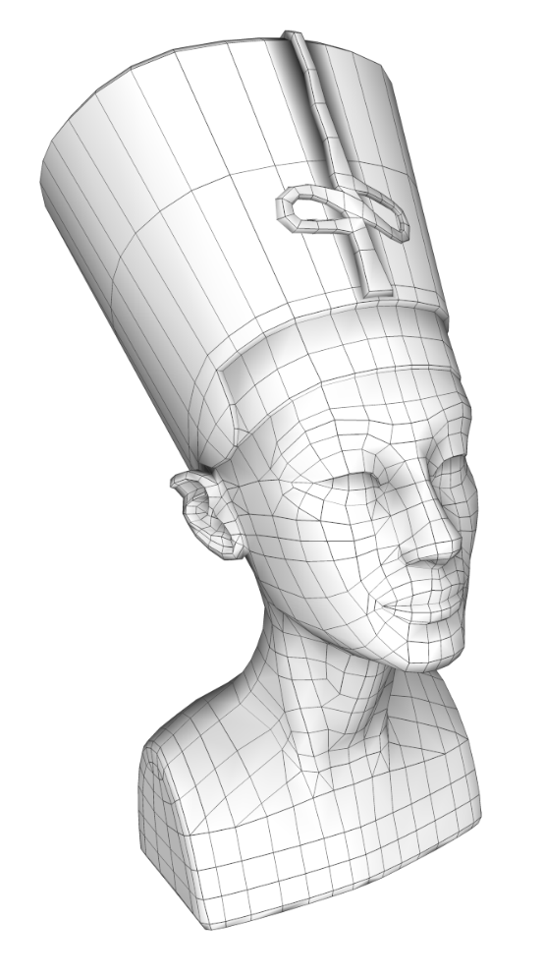
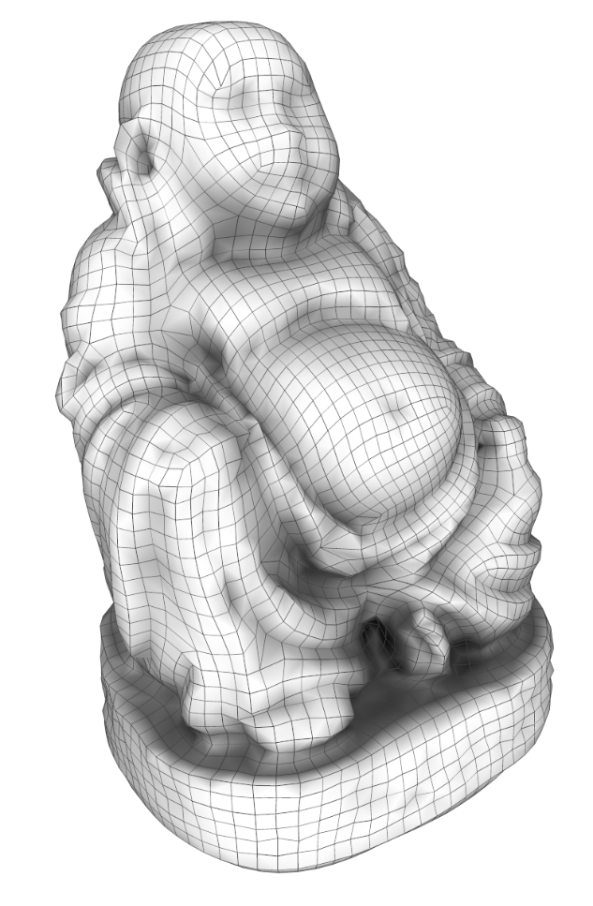
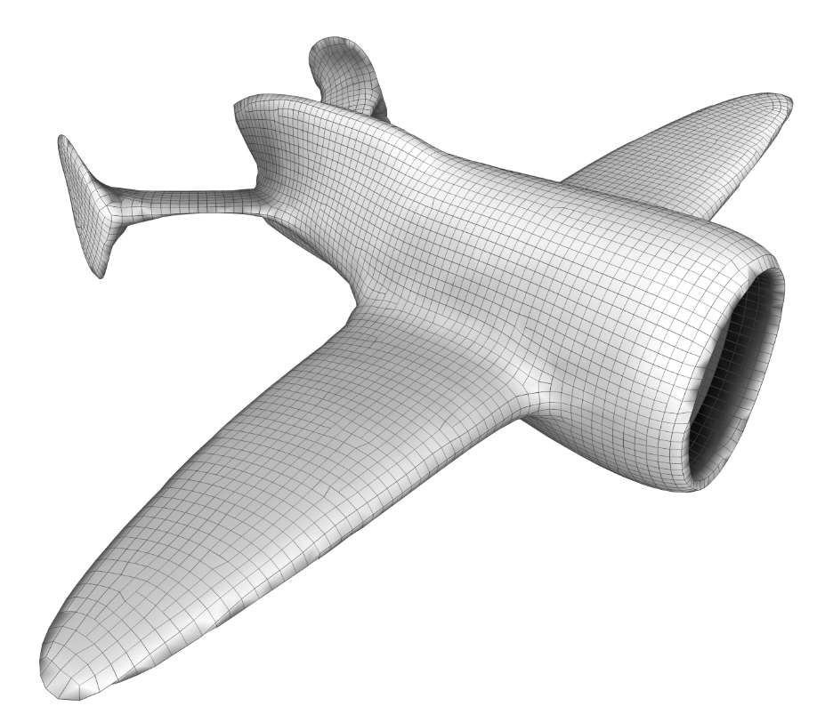
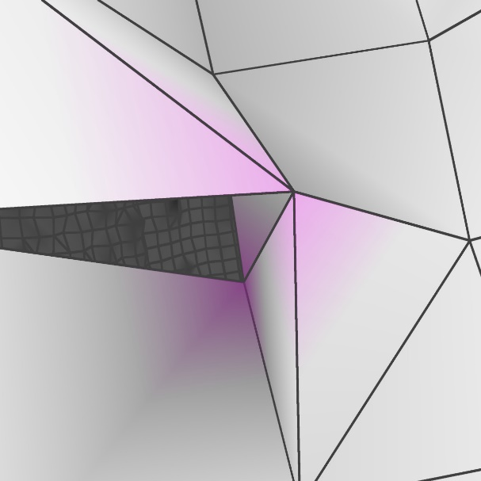
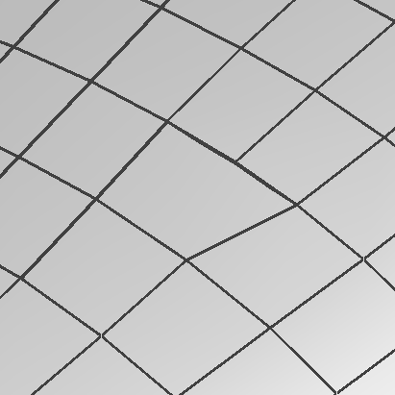

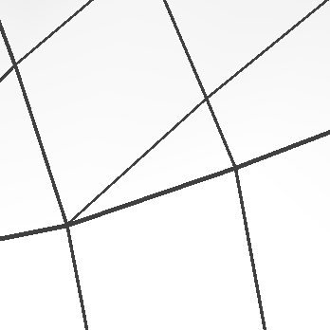
Imperfect Quad-Dominant Meshes
Scanning:
Remeshing:
Hand-Crafting:
Online Surface Reconstruction [Schertler 2017]
Instant Meshes [Jakob 2014]
Integer Grid Maps [Ebke 2016]
© ozgursrl (TurboSquid)
Notes:
0:29 – 1:46

Slide 3

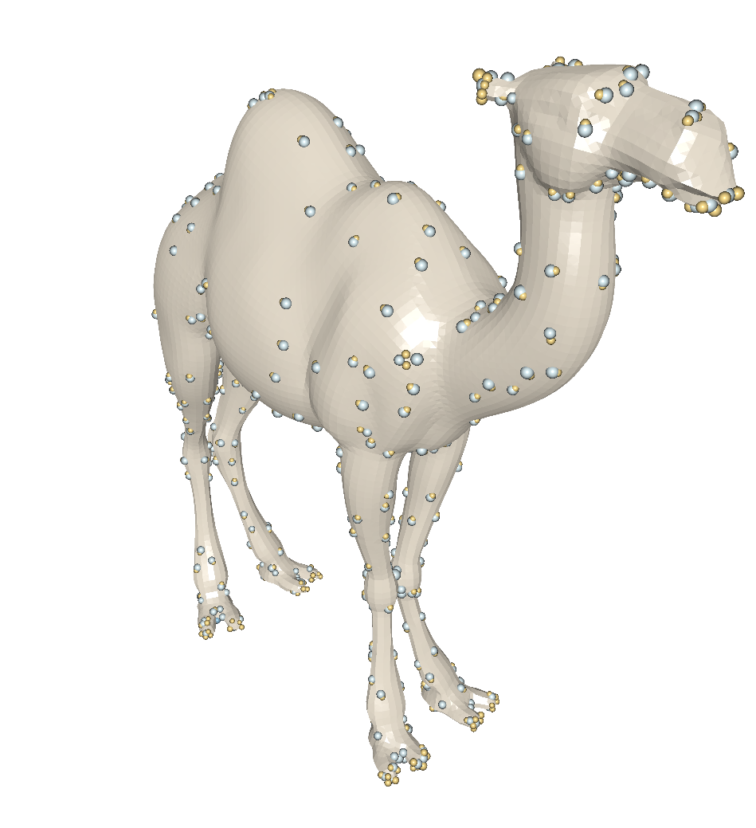
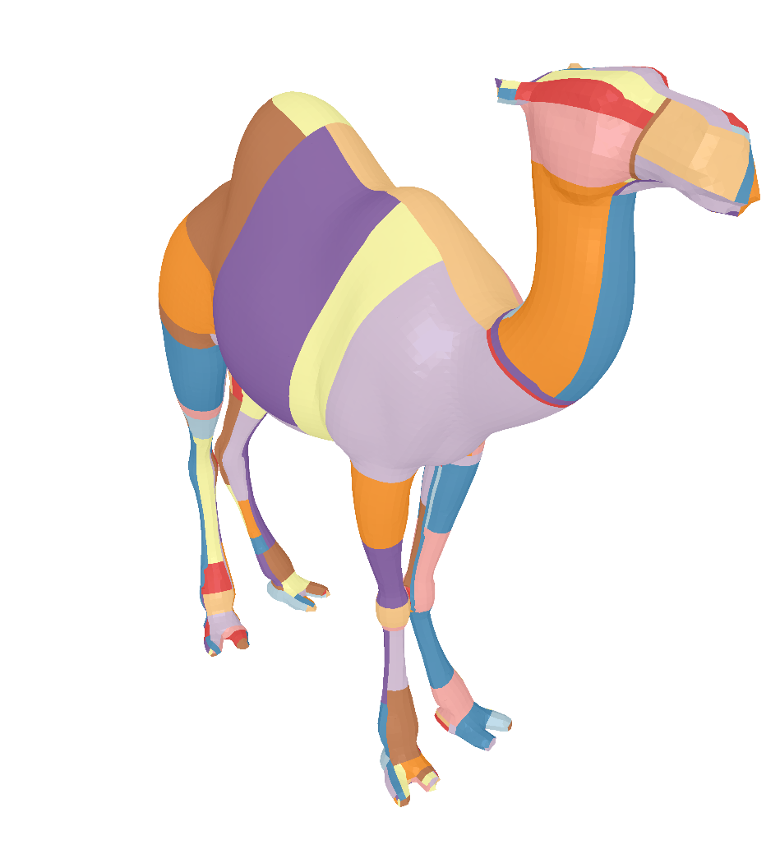

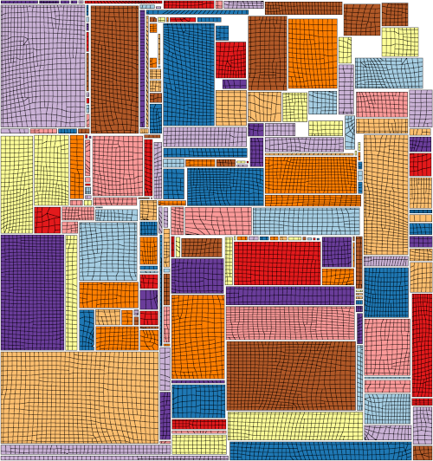
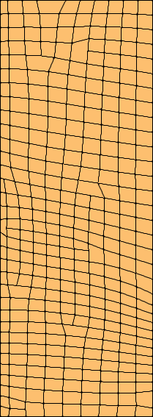
Problem Description
Input
Quad Partitioning
Parametrization
Notes:
1:46 – 3:14

Slide 4
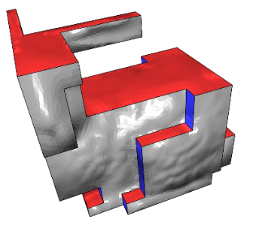
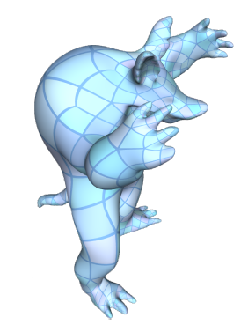
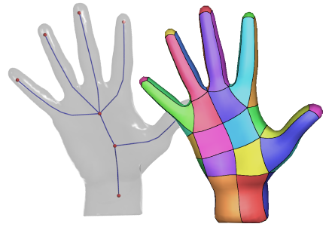
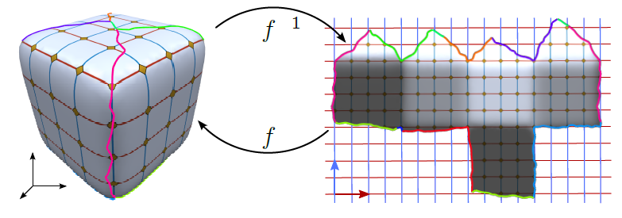
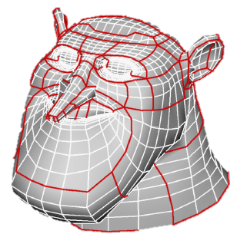
Quad Layouts
Poly-Cubes
Iterative Simplification
Curve-Skeleton
[Panozzo 2011]
[Usai 2015]
[Fu 2016]
Parametrization
Line Tracing
[Bommes 2013]
[Eppstein 2008]
Notes:
3:14 – 3:46

Slide 5
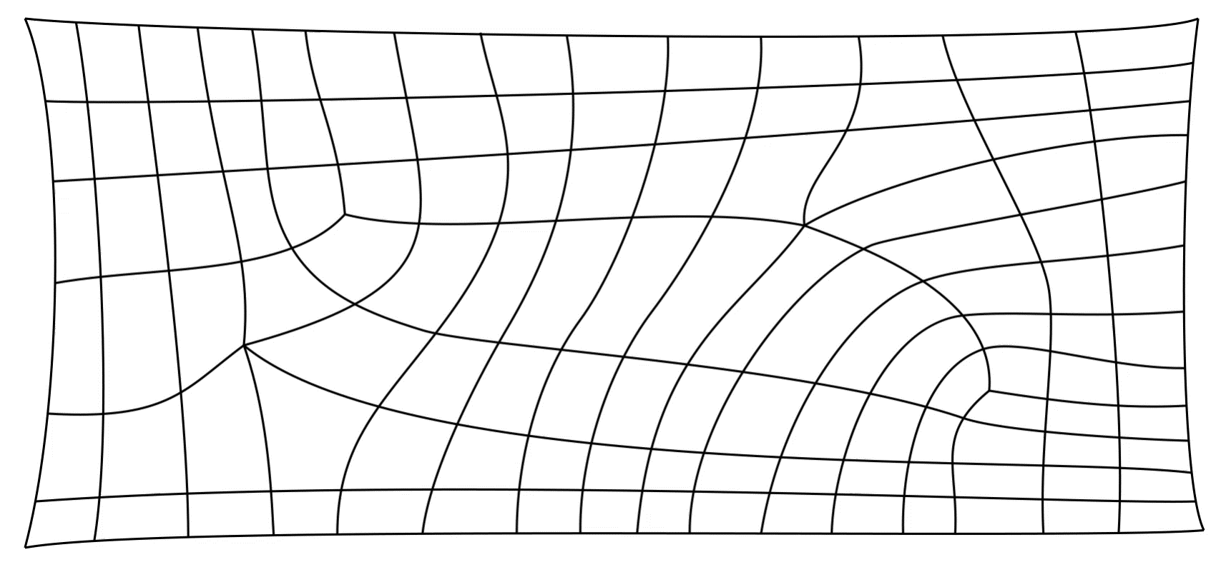
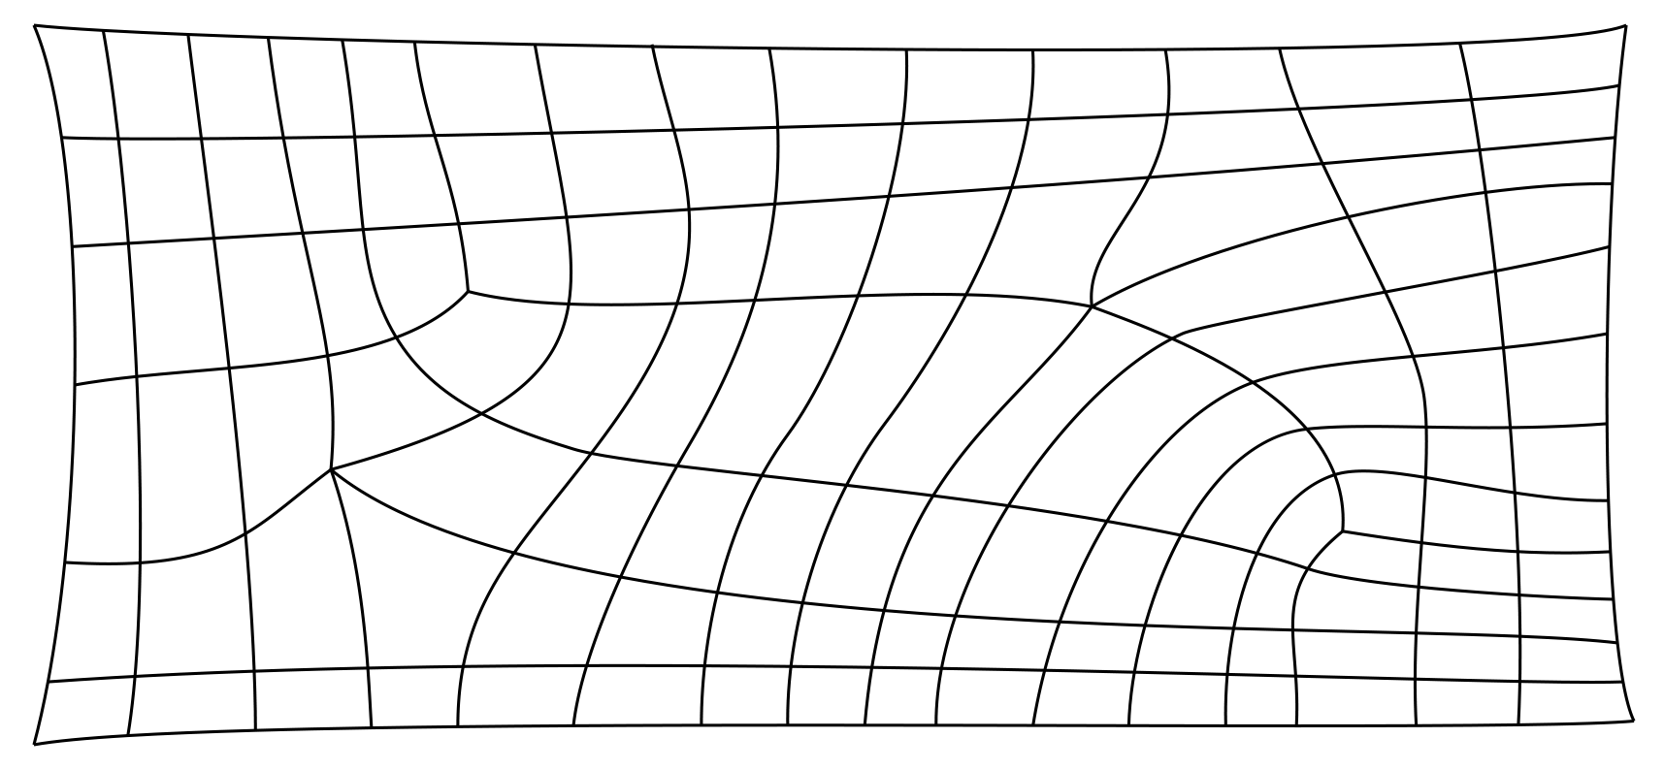
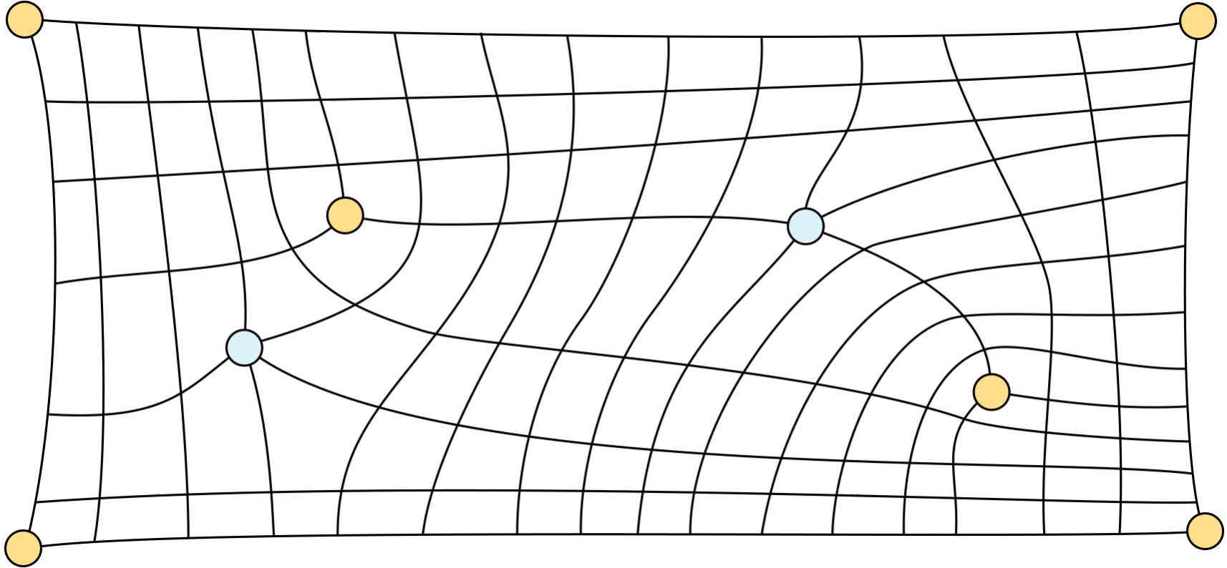
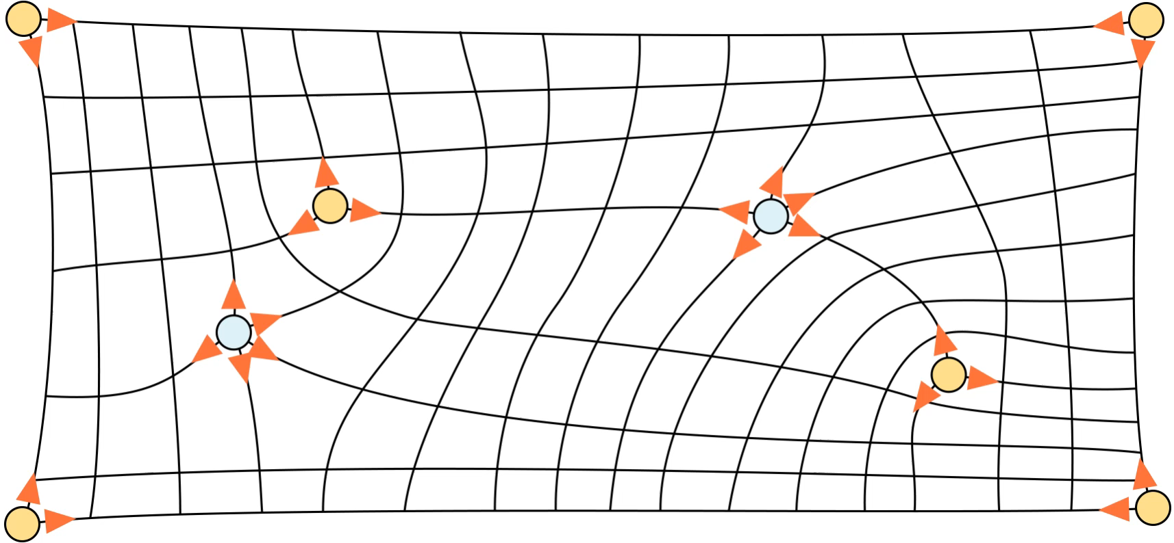
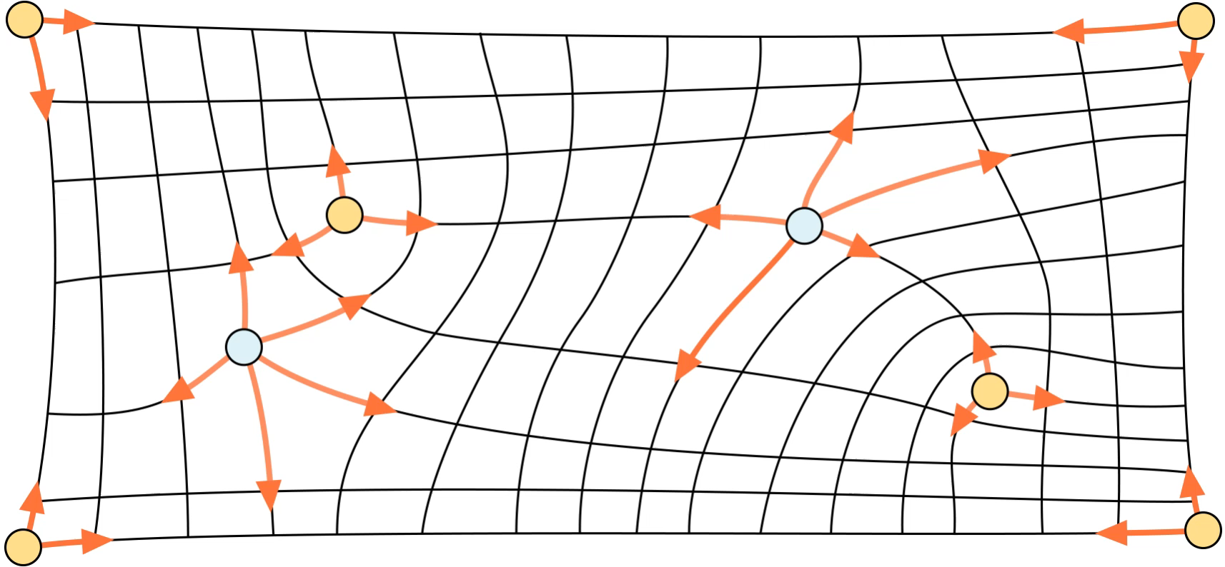
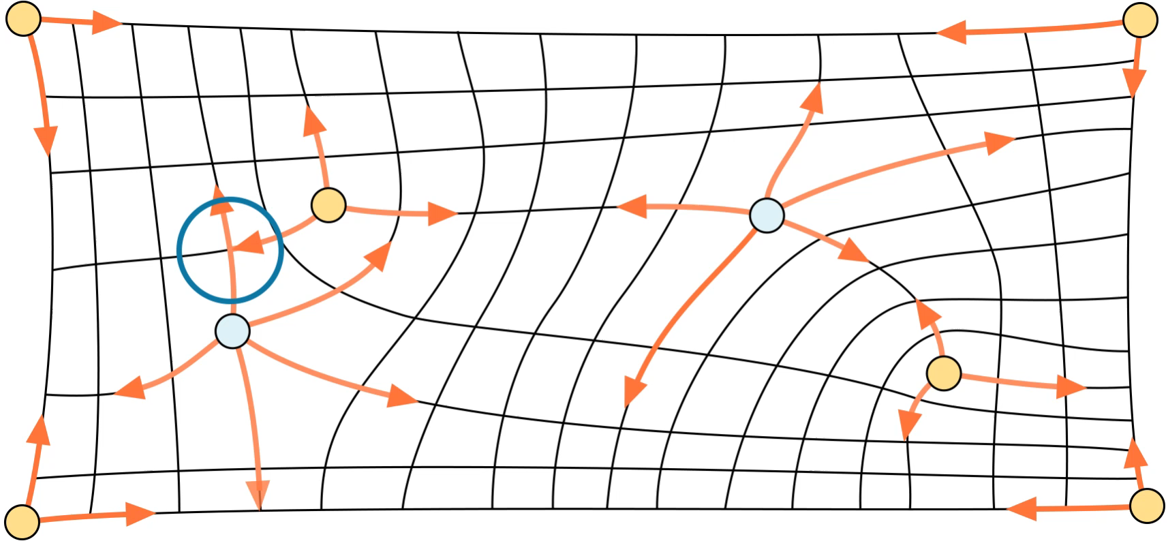
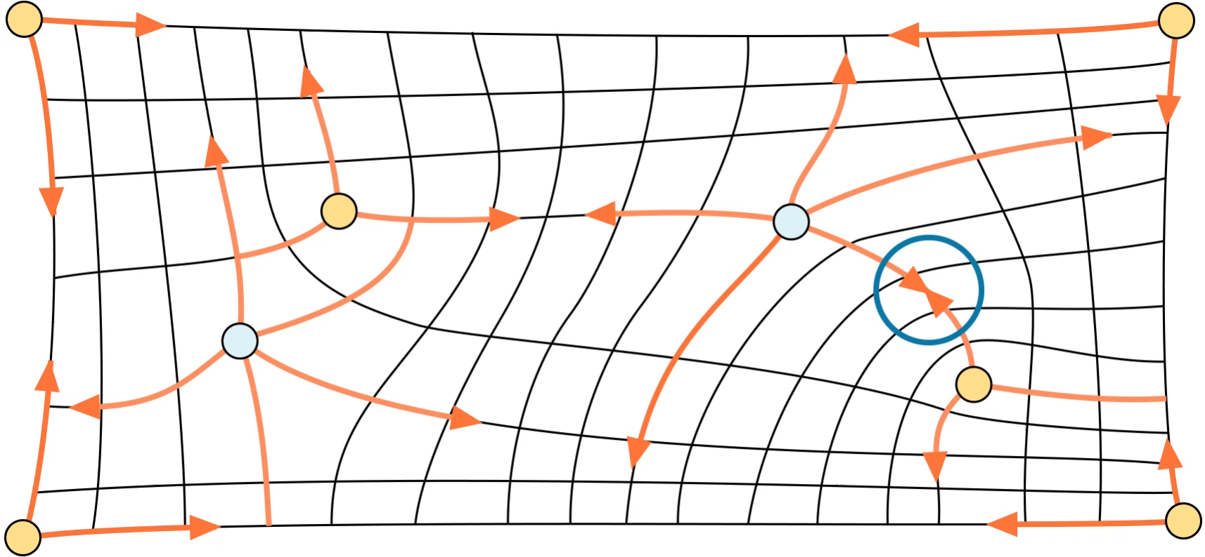
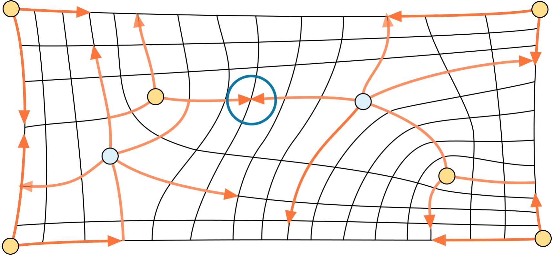
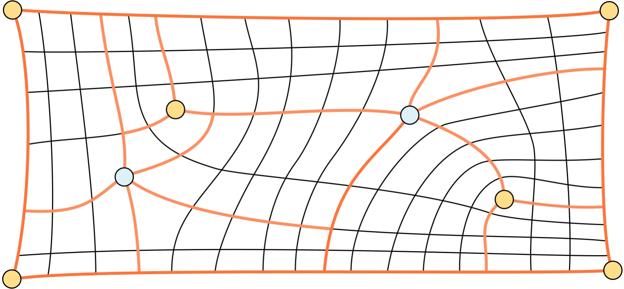
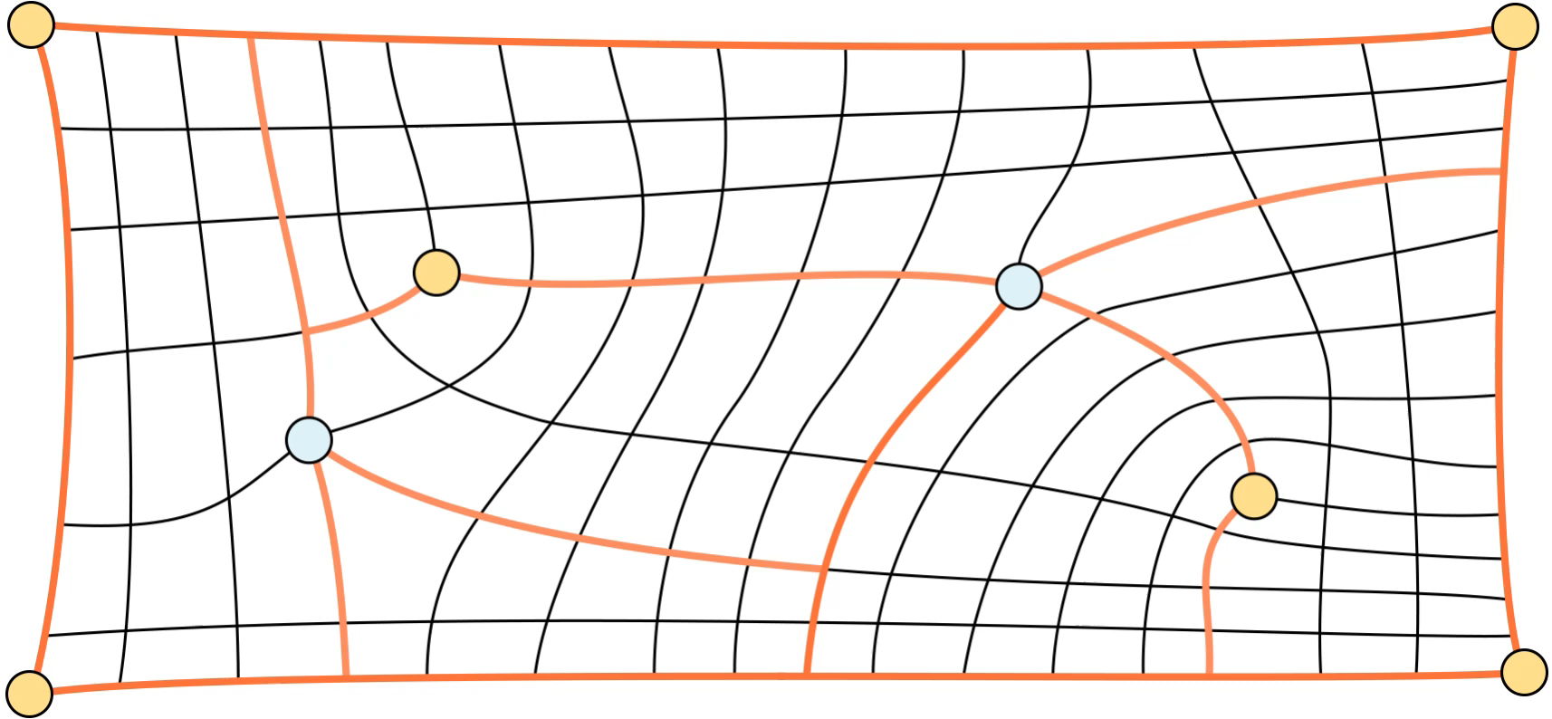
Original Motorcycle Graph [Eppstein 2008]
Notes:
3:46 – 5:44

Slide 6
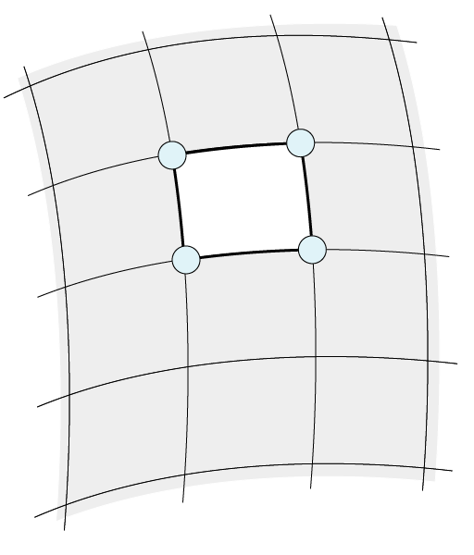
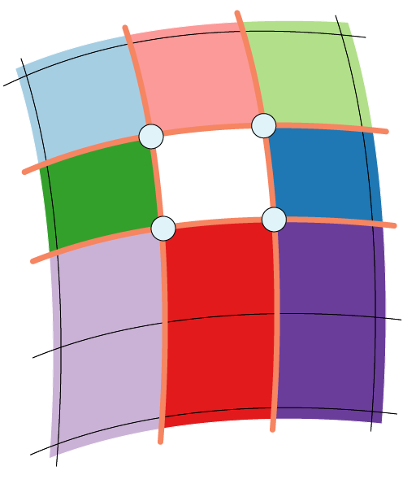

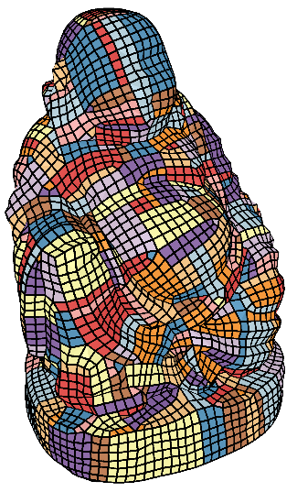
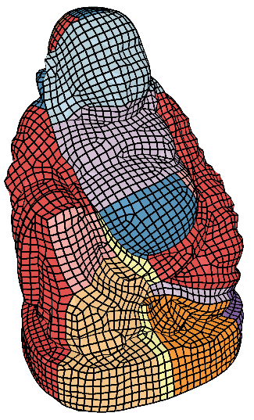
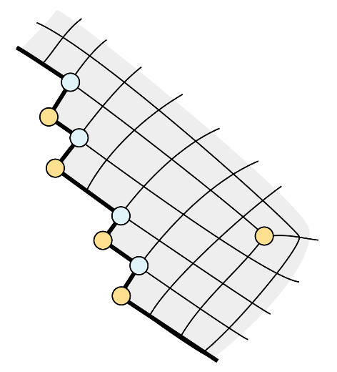
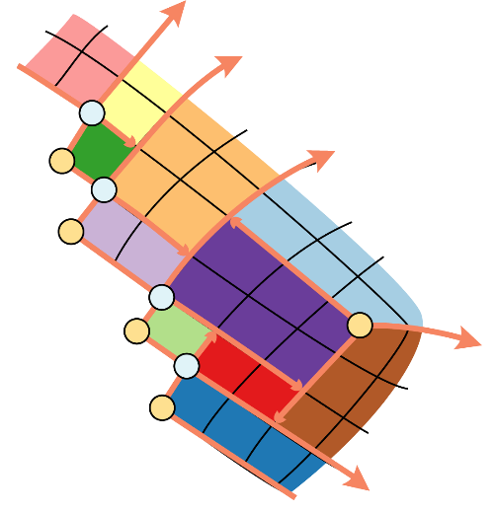
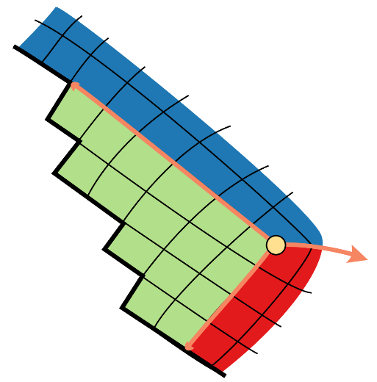

Problems of the Original Motorcycle Graph for Imperfect Meshes
Non-Quadrilateral Faces
Holes
Catmull Clark
Redundant Irregular Vertices
Jagged Boundaries
[Eppstein 2008]
[Ours]
385 patches
24 patches
[Eppstein 2008]
[Ours]
[Eppstein 2008]
[Ours]
Notes:
5:44 – 7:34

Slide 7
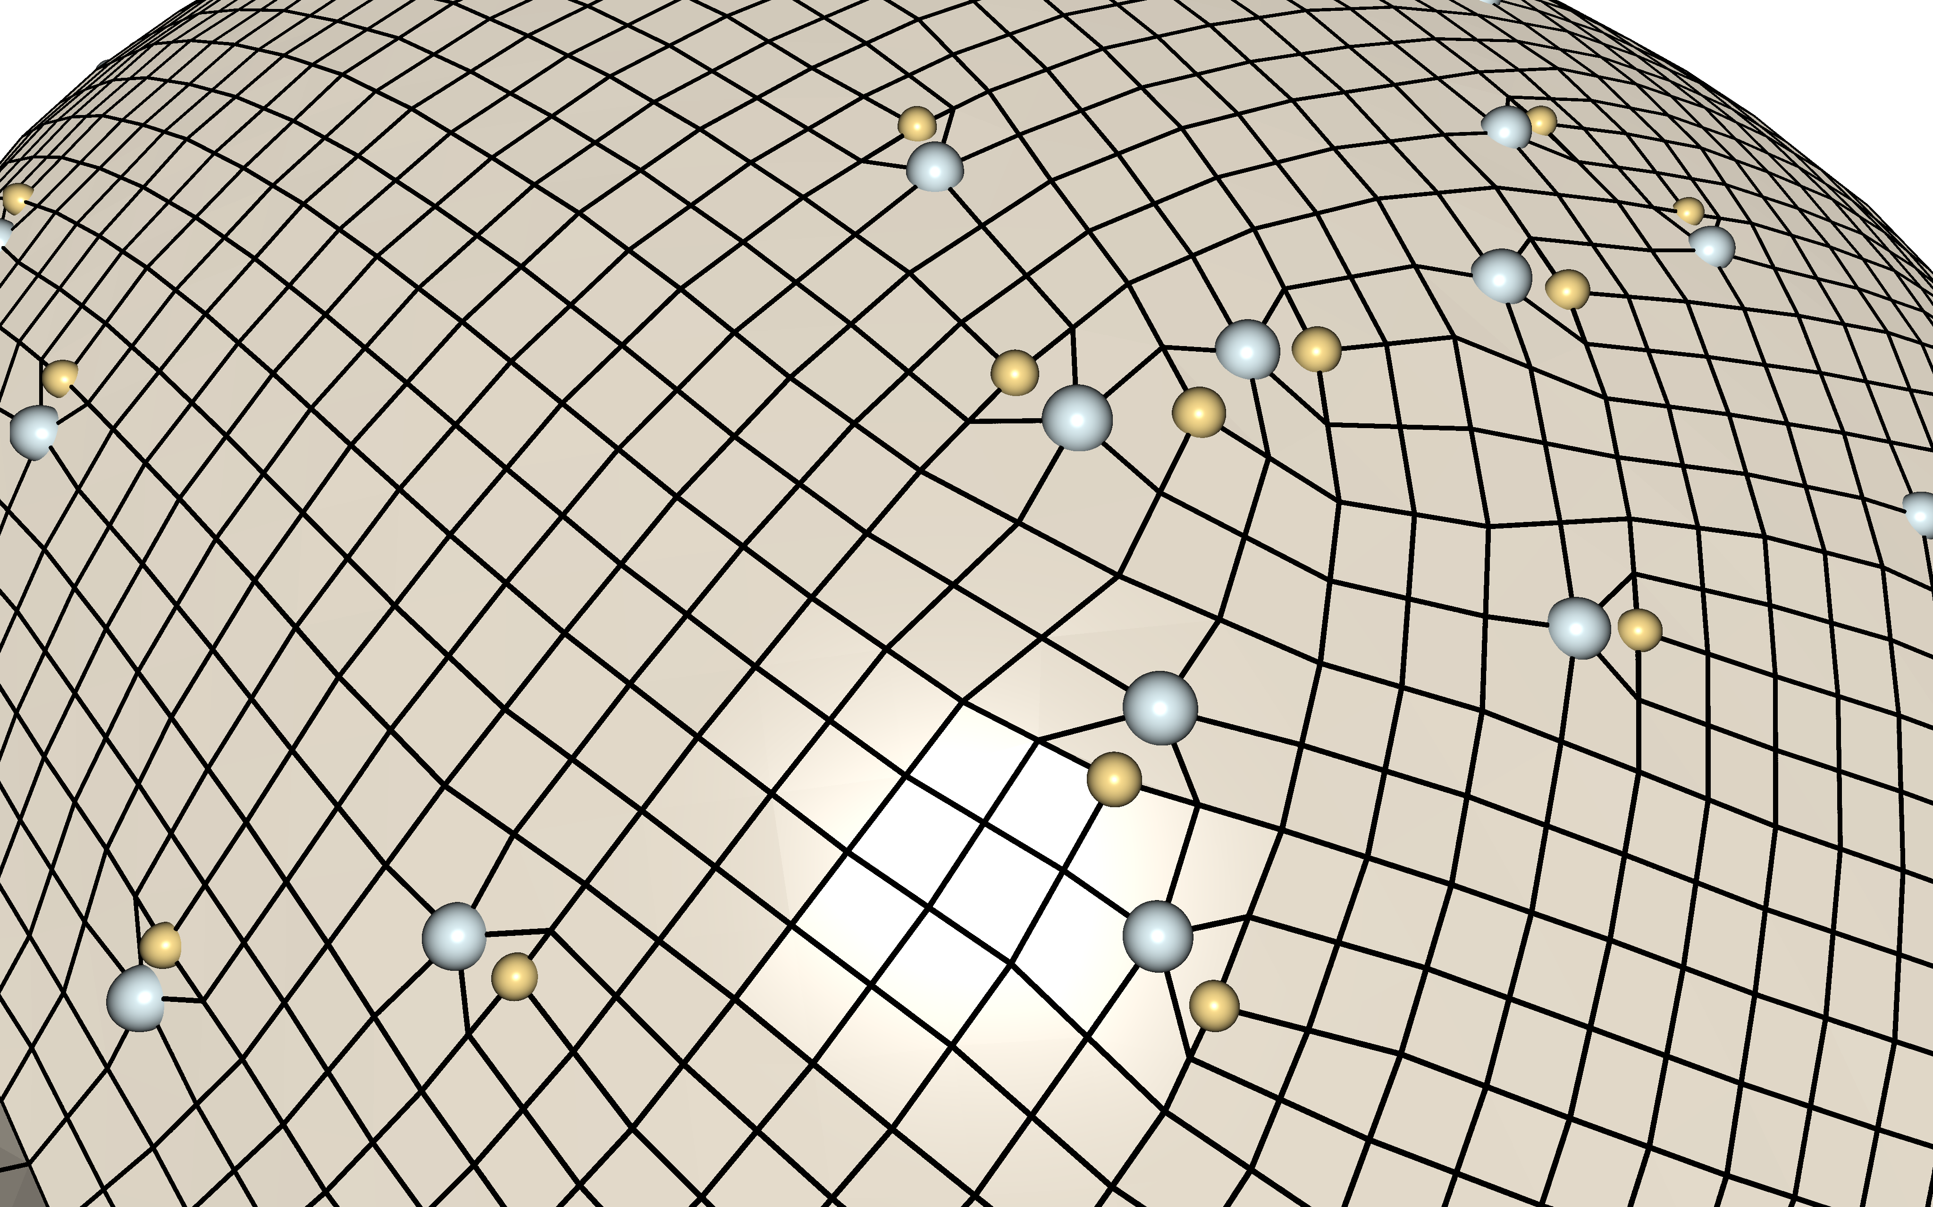
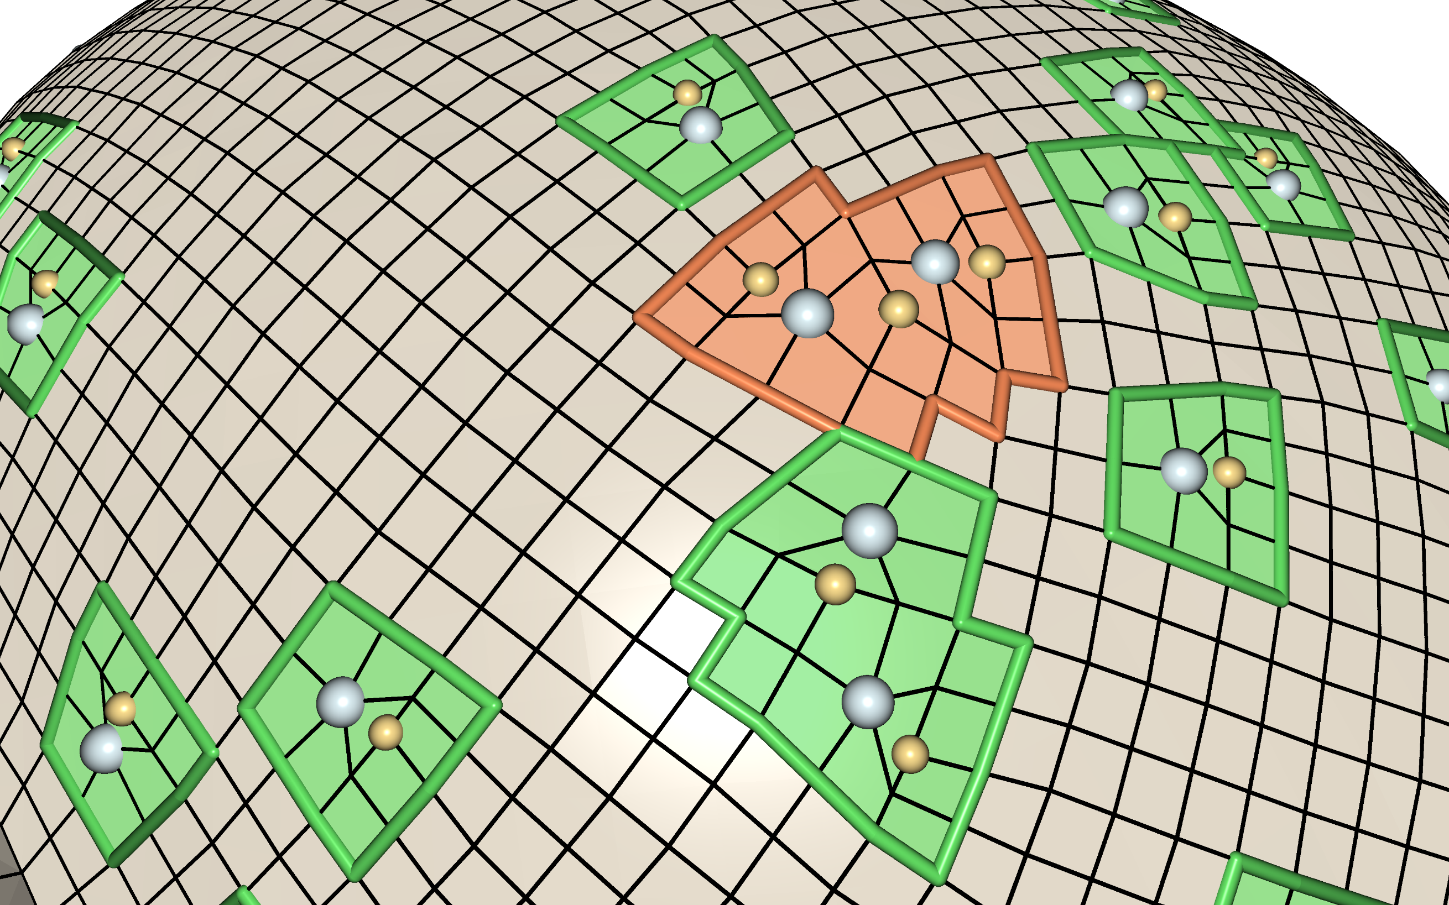
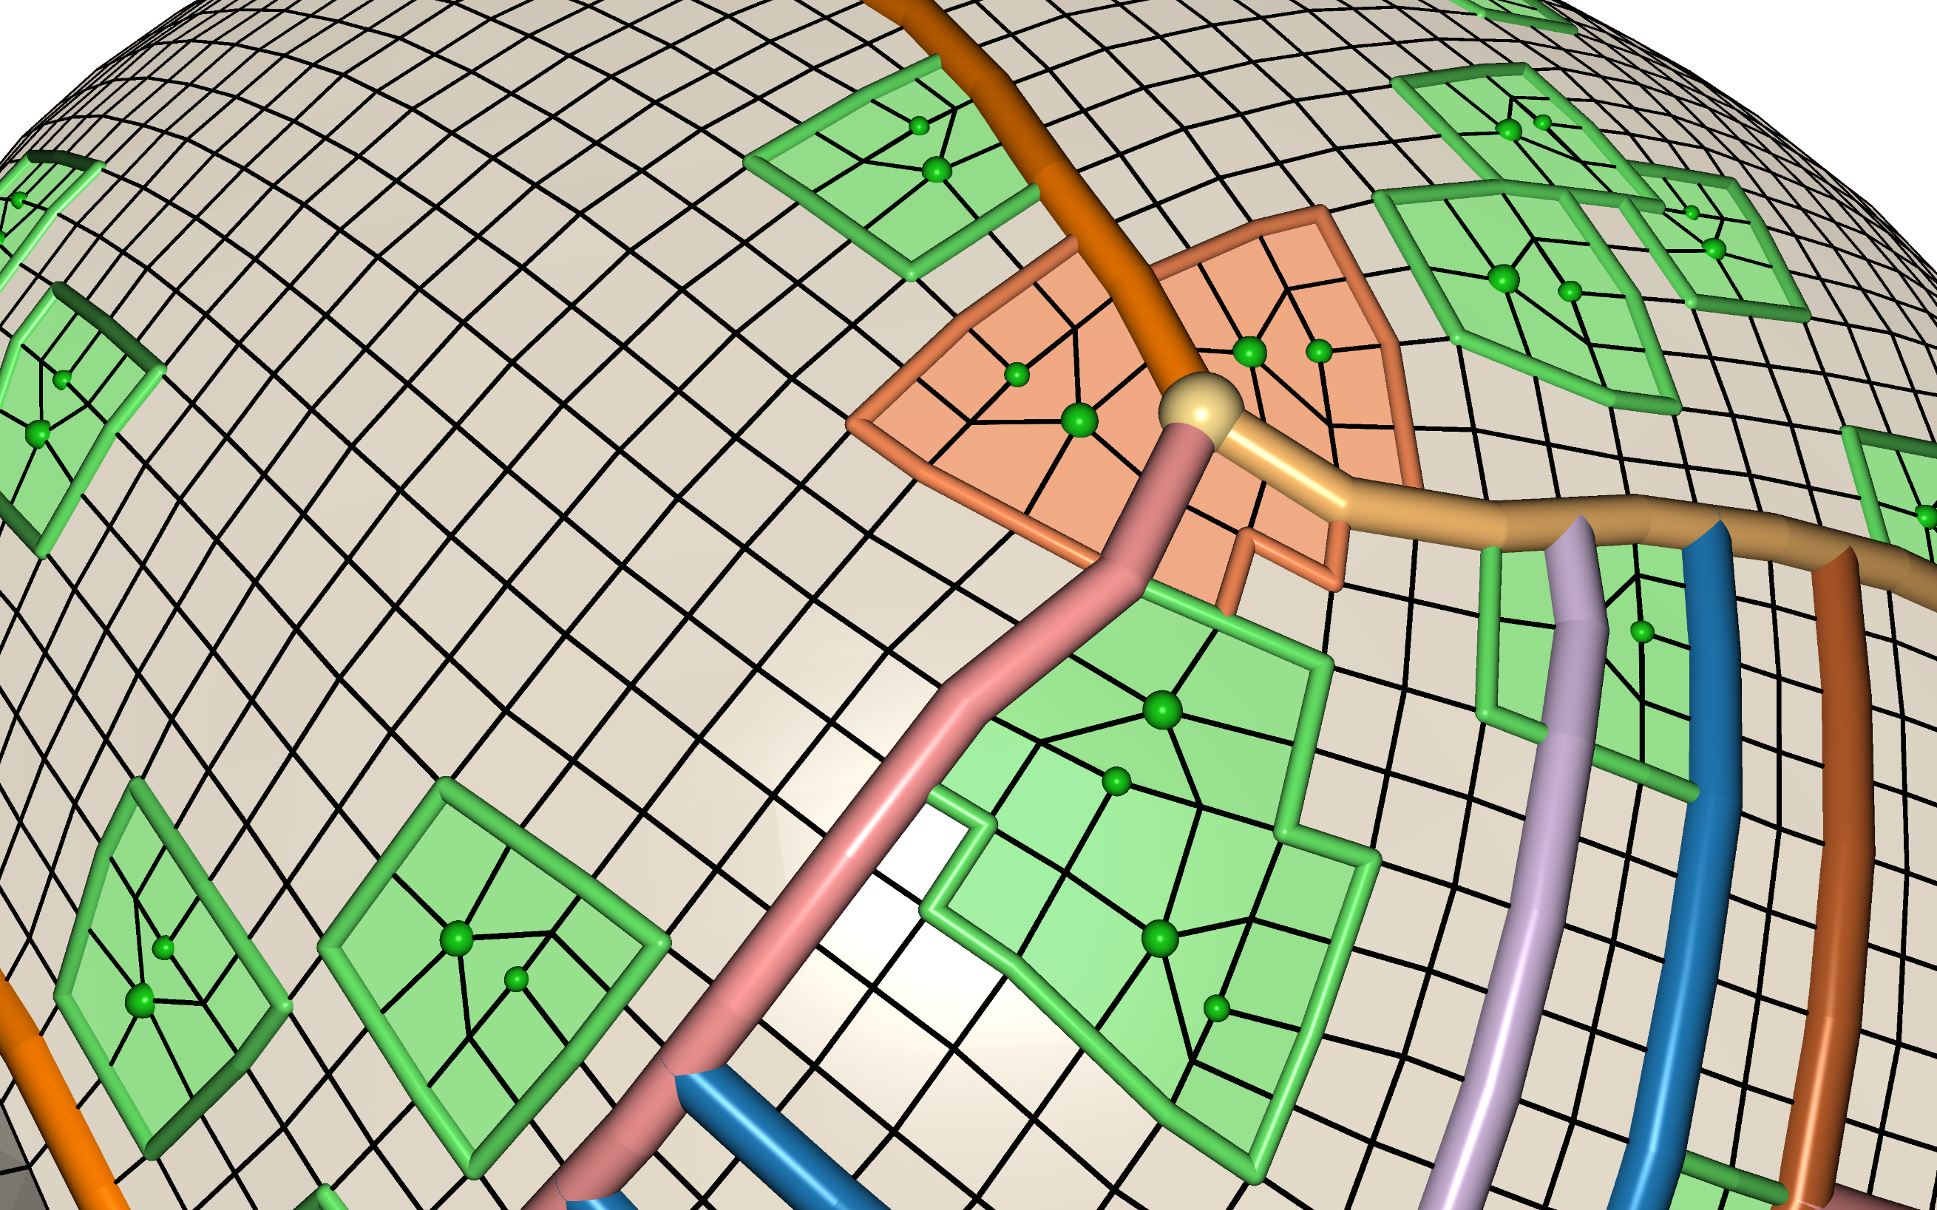
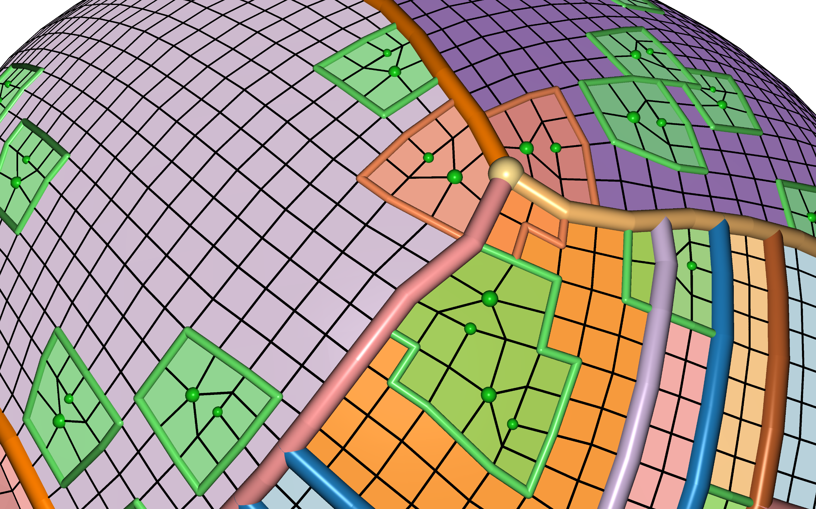
Fenced Regions
Fenced Regions
Notes:
7:34 – 9:49

Slide 8
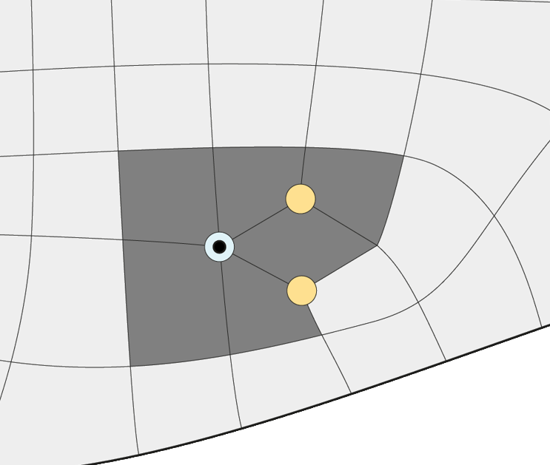
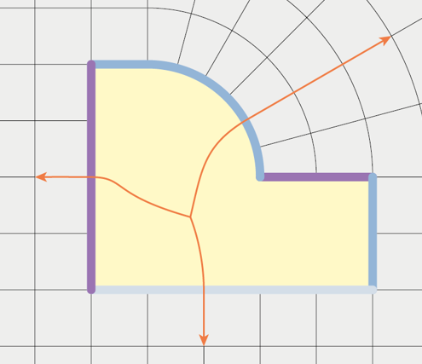
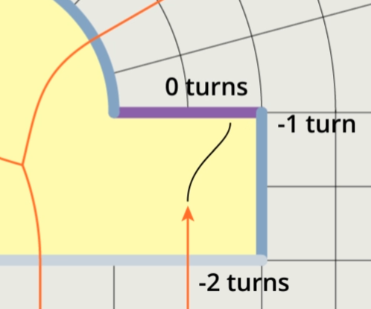
Fenced Regions
How to generate?
How to spawn motorcycles?
How to trace through?
Notes:
9:49 – 10:09

Slide 9
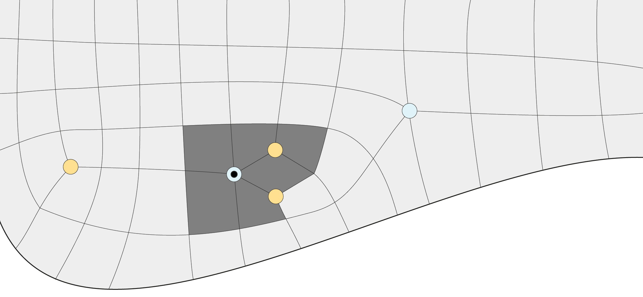
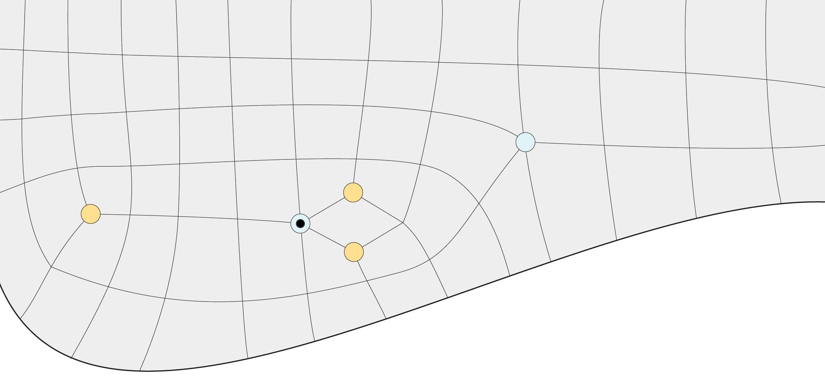
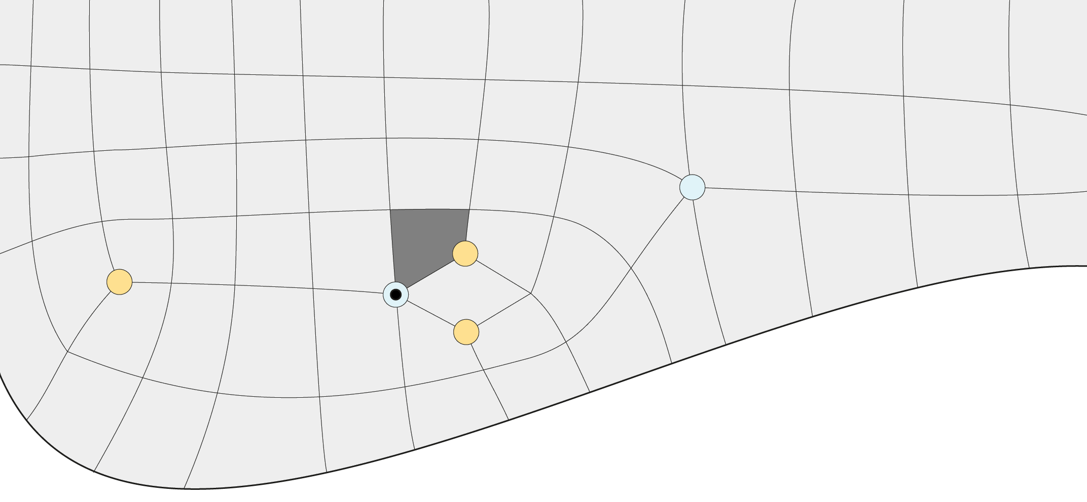
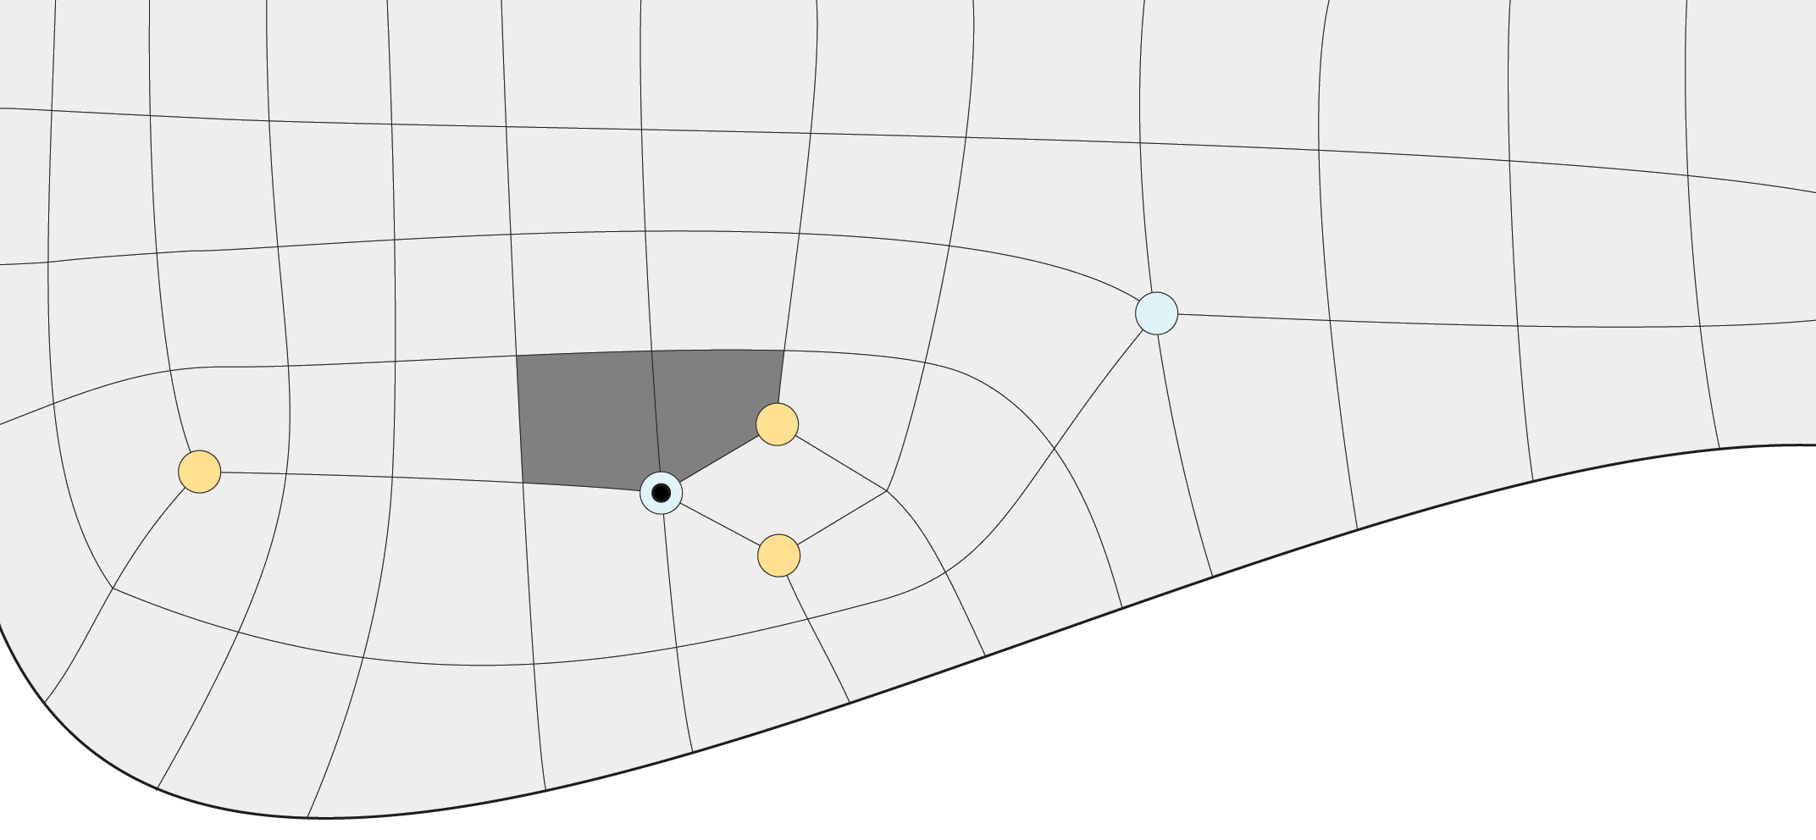
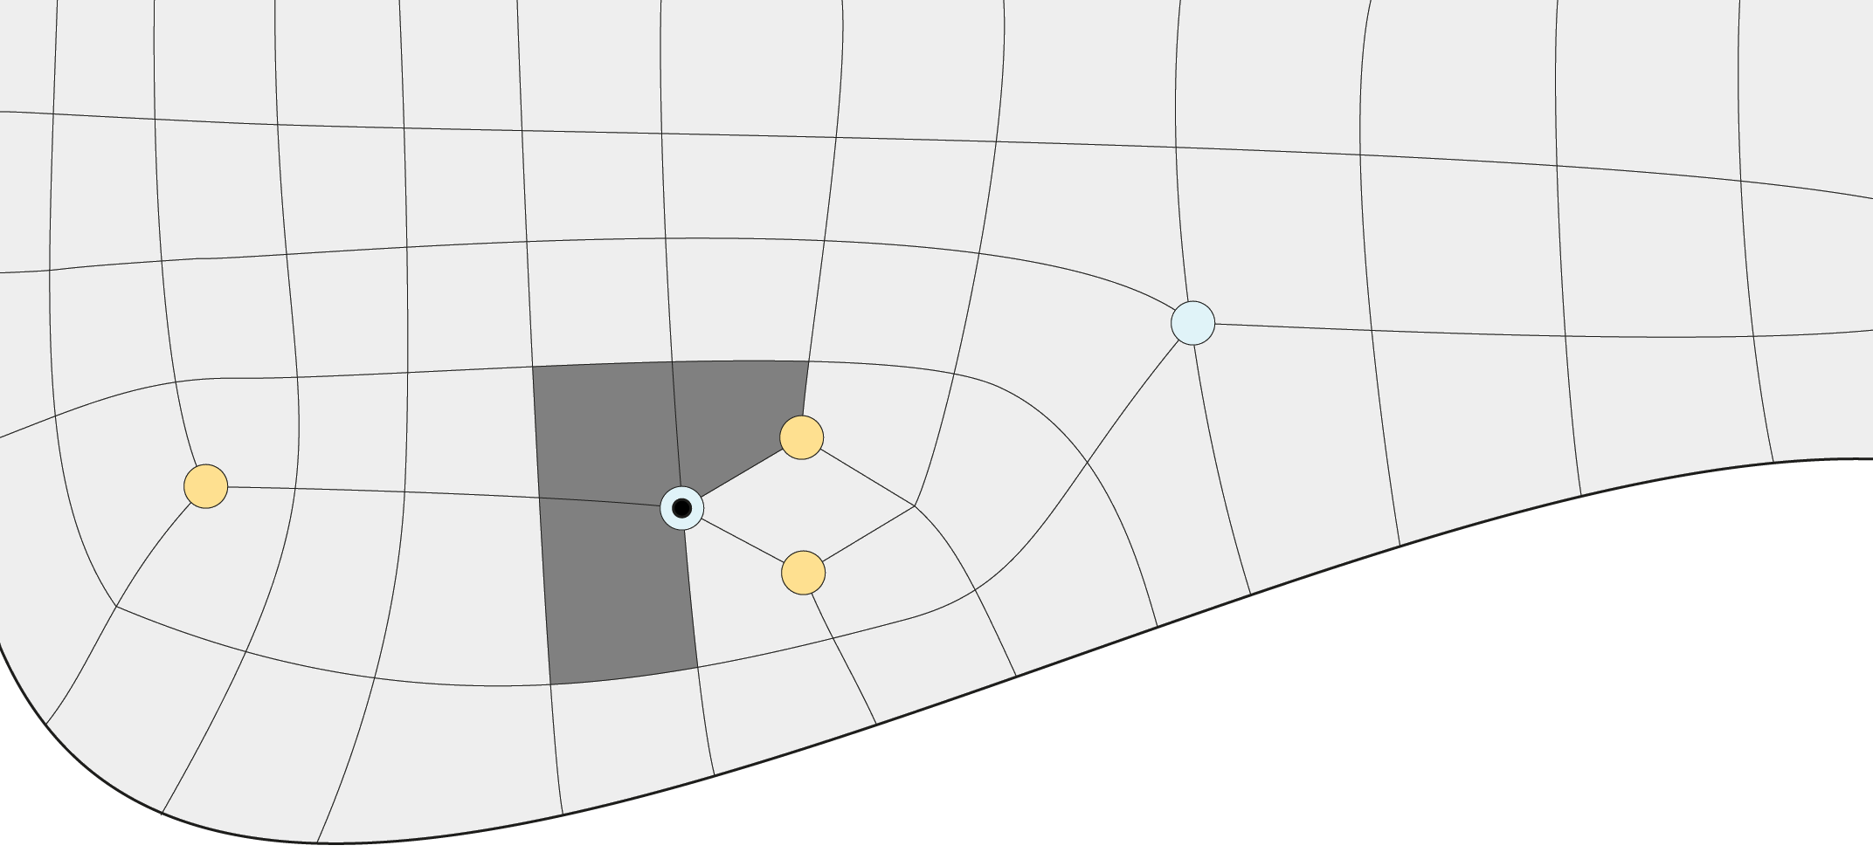
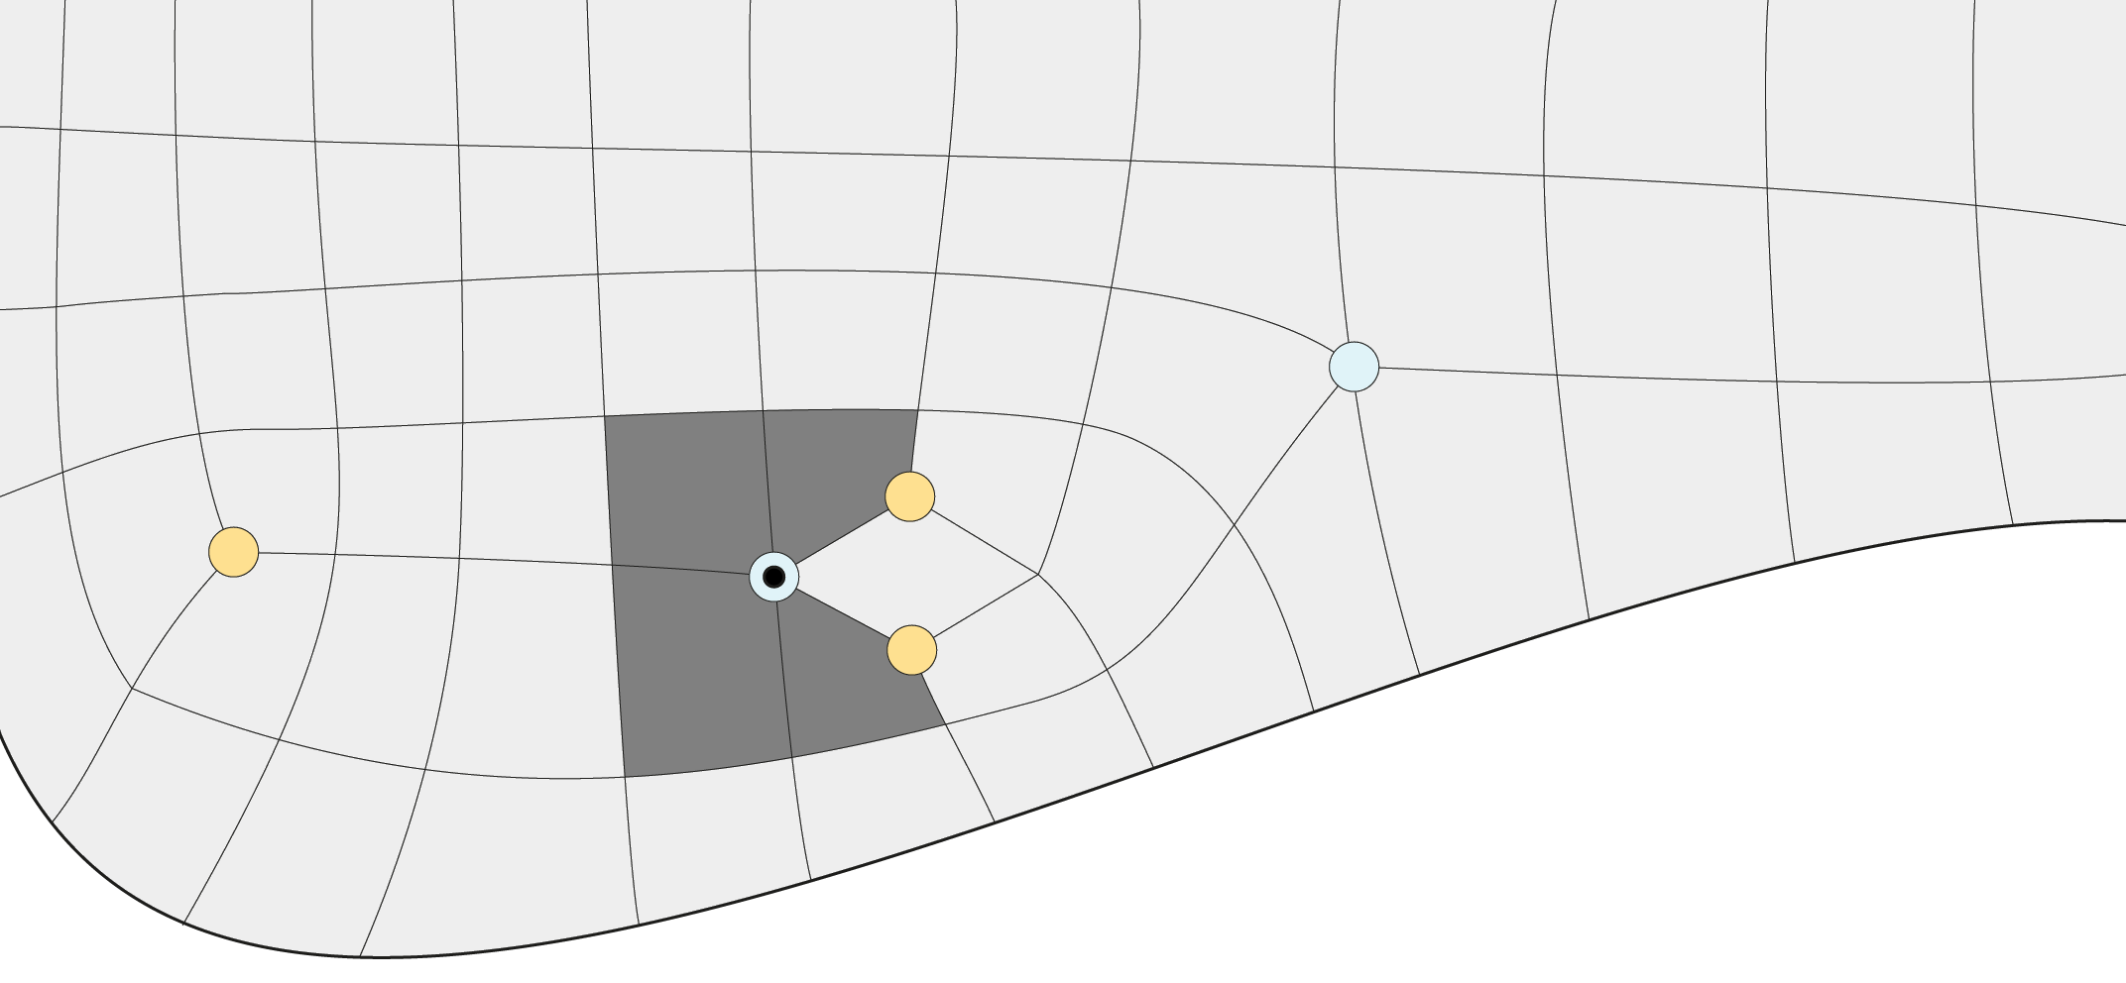
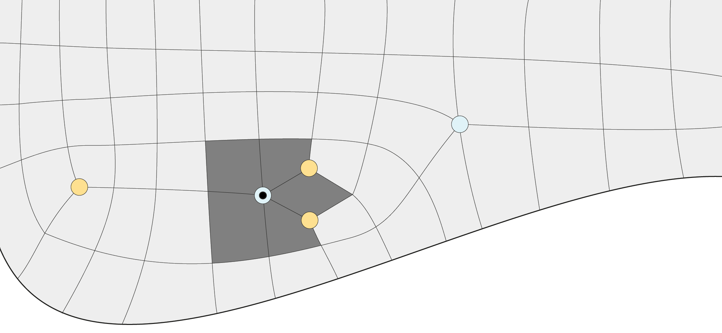
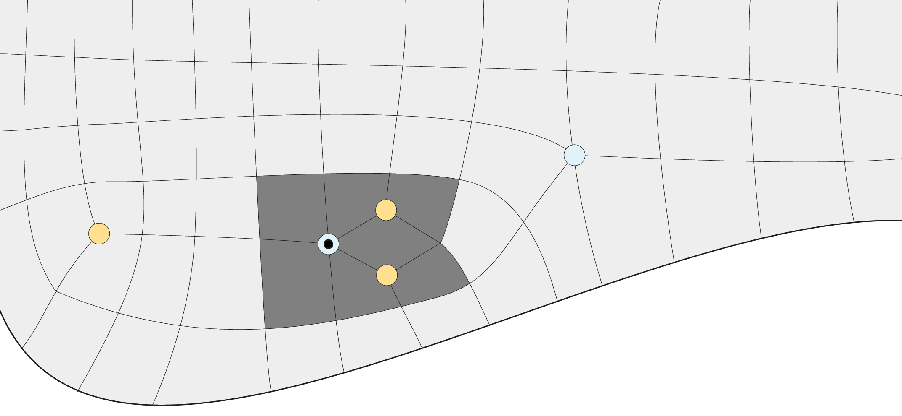
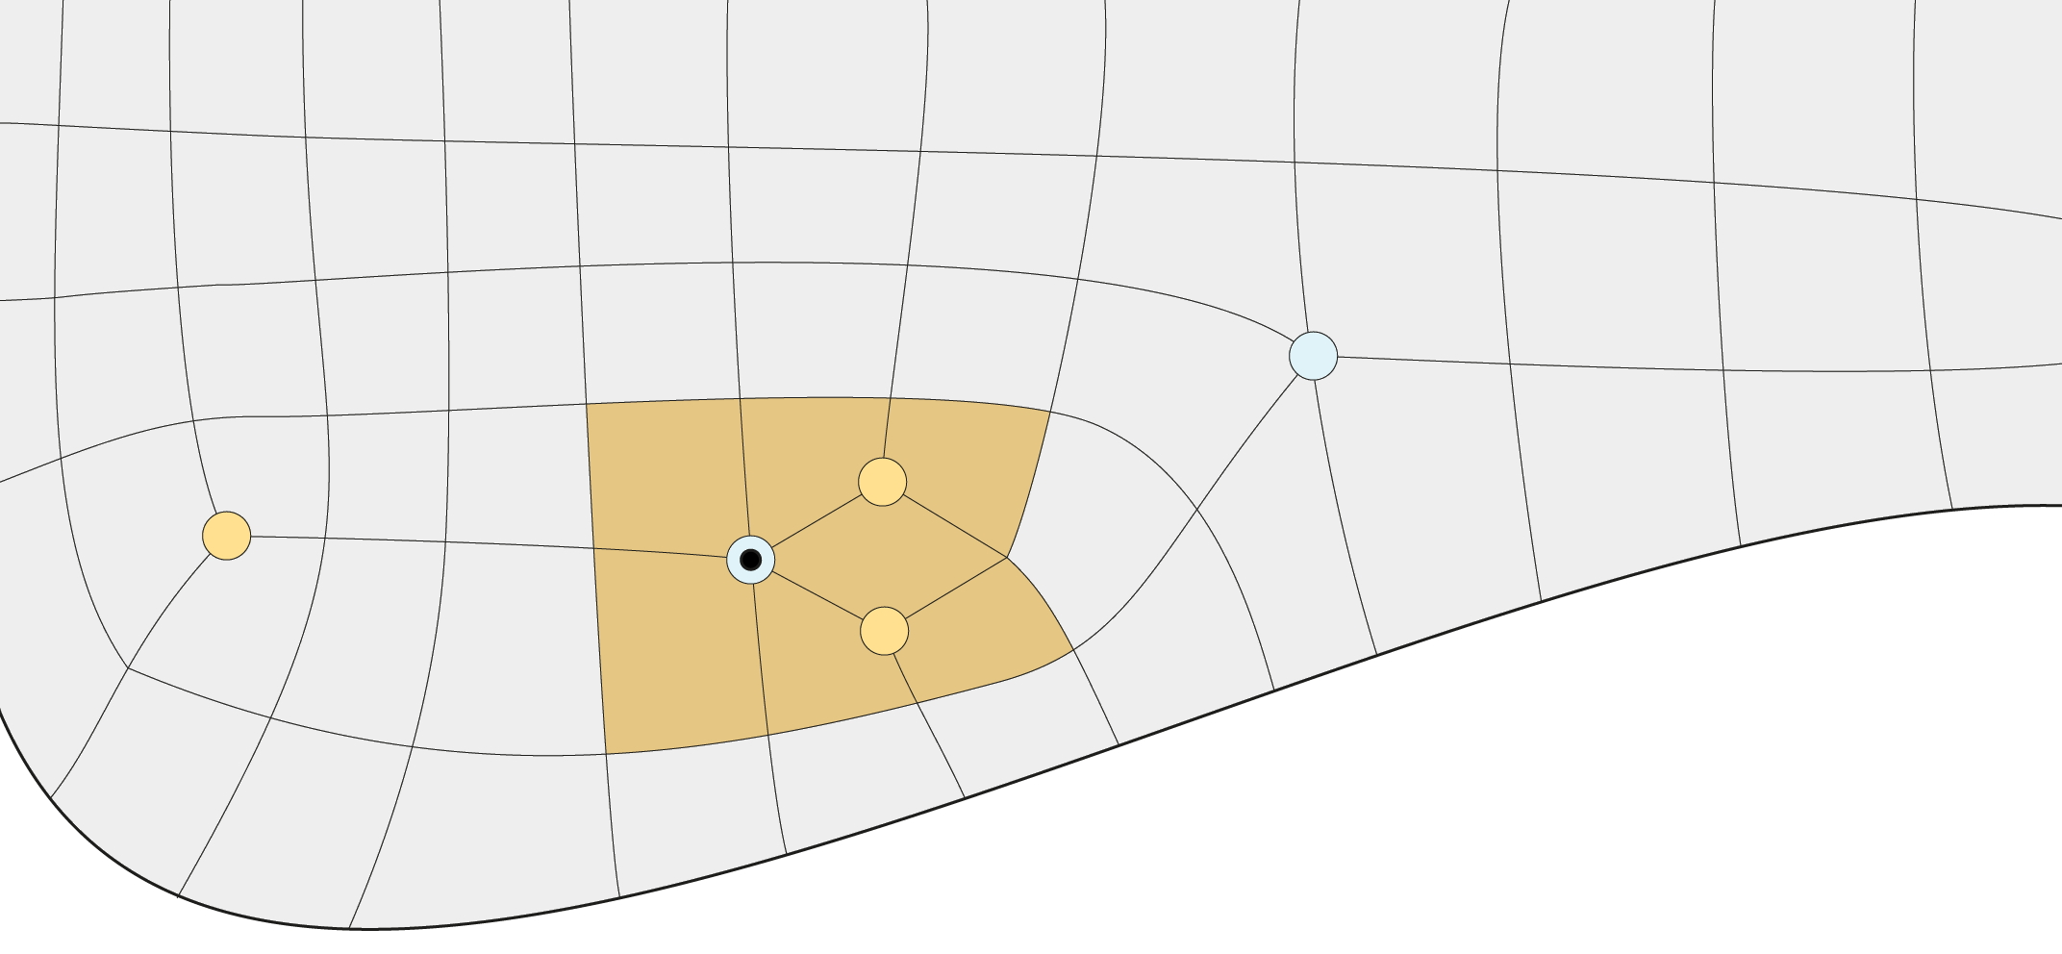
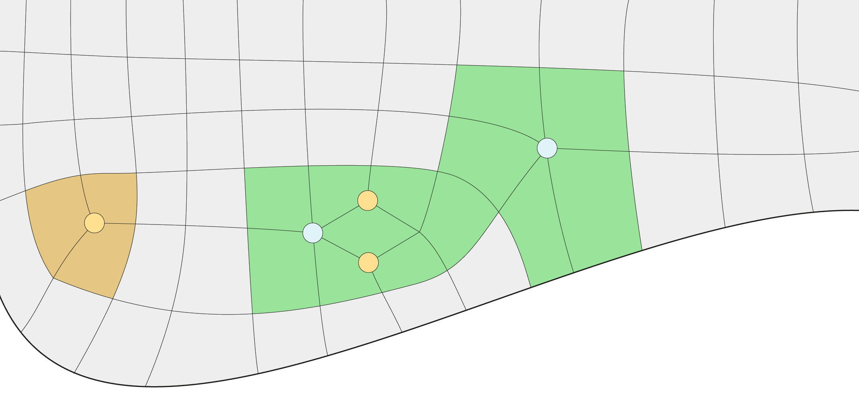


Generating Fenced Regions
Notes:
10:09 – 12:04

Slide 10







Spawning Motorcycles
Orientation 0
Orientation 1
Orientation 2
Notes:
12:04 – 13:30

Slide 11




Tracing Through Fenced Regions
Orientation 0
Orientation 1
Orientation 2
Notes:
13:30 – 14:53

Slide 12










Result
Notes:
14:53 – 15:39

Slide 13
Results

Slide 14








Comparison
(1,314 patches)
Autodesk Maya 2017
(55.8 % occupancy)
Generalized MCG
(704 patches)
Original MCG (15,843 patches)
(97.6 % occupancy)
Notes:
15:39 – 16:56

Slide 15

Applications – Texture Condensation
Original Texture
Condensed with GMCG
Notes:
16:56 – 17:19

Slide 16

Applications – Invisible Seams
Visible Seams
Invisible Seams
Notes:
17:19 – 17:41

Slide 17
Questions?
Code available at https://github.com/NSchertler/GeneralizedMotorcycleGraph
Notes:
17:41 – 18:00

Slide 18
Limitations

